Slide 1


We accumulated 19 metrics and 12 visualizations within our dashboard to equip coaches with tools to enhance individual player training programs as well as recruiting efforts.

Slide 3


Slide 4
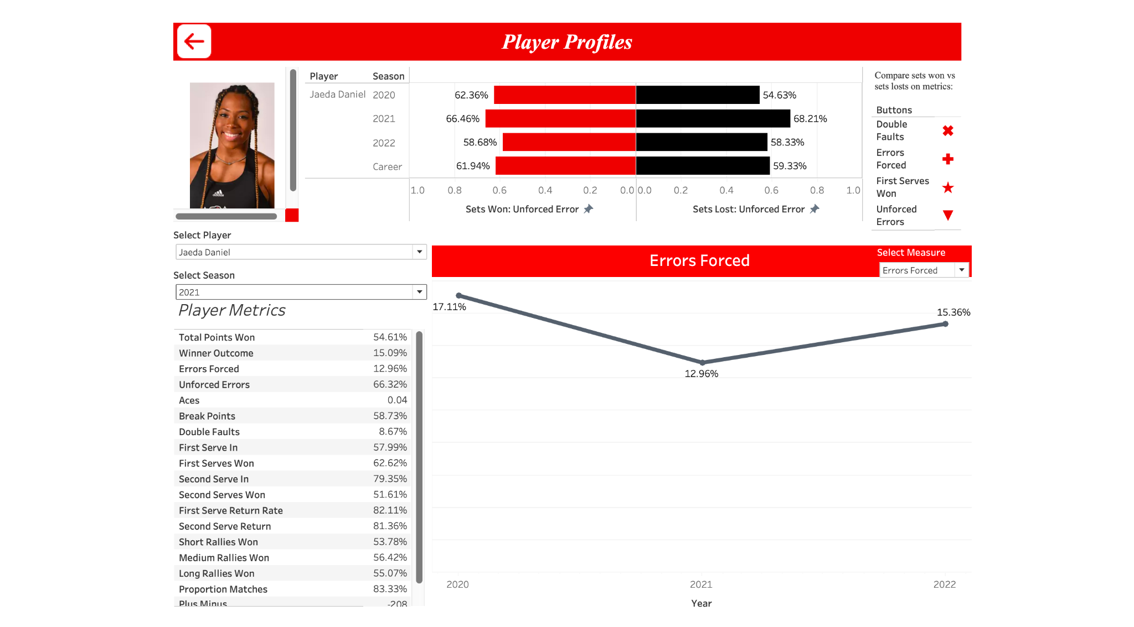

Slide 5
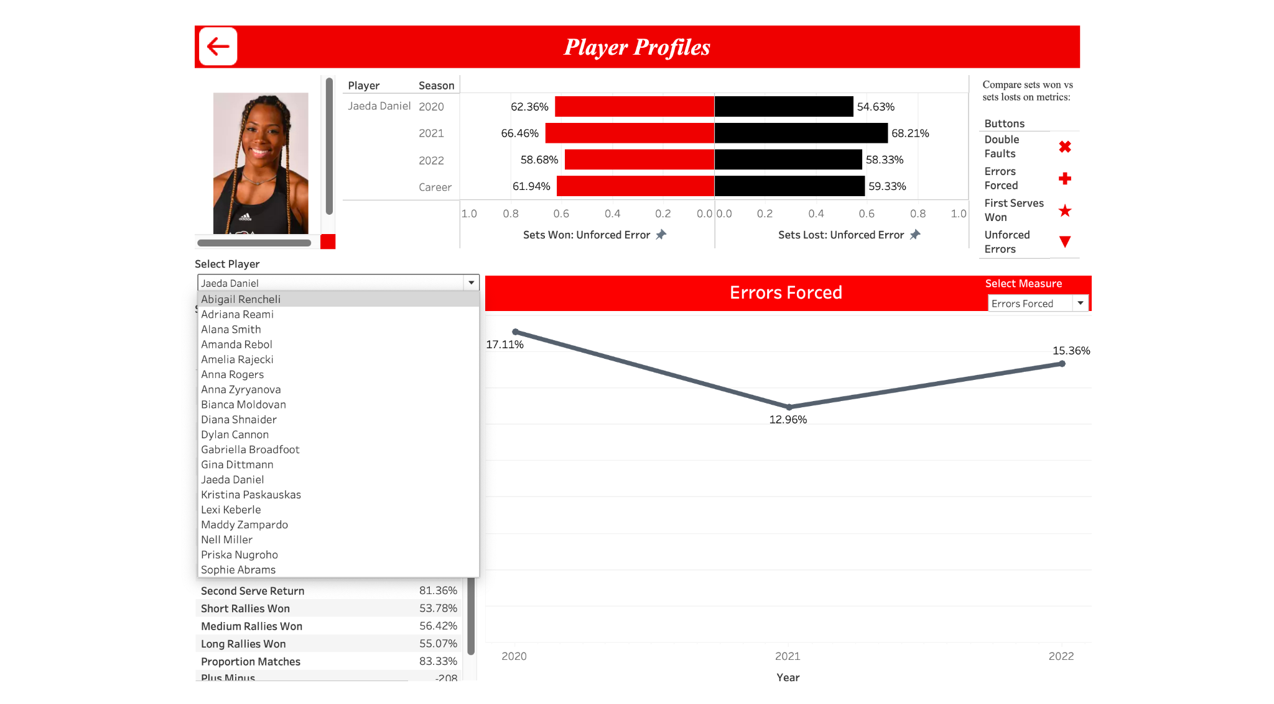


Slide 6
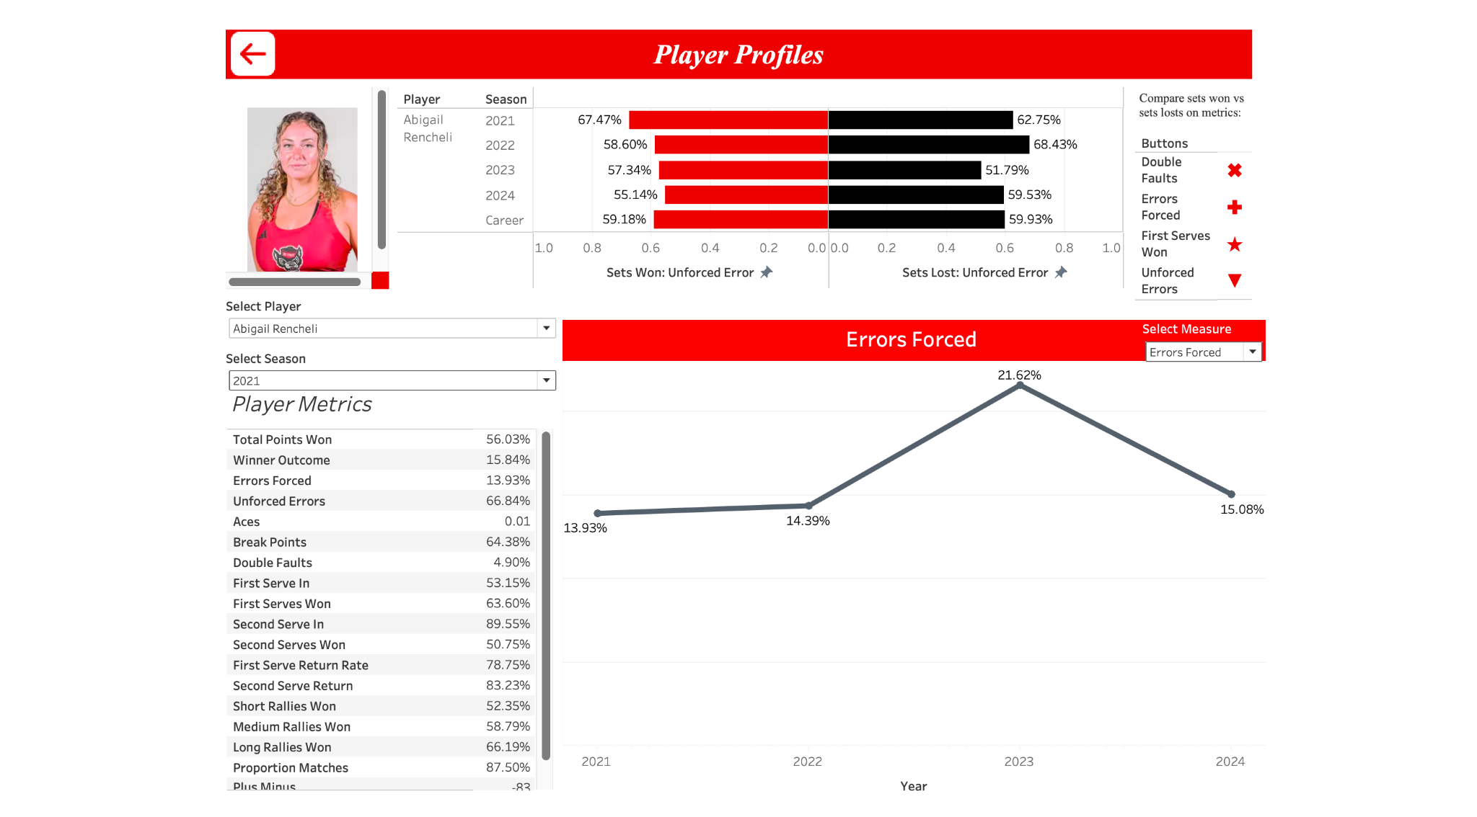

Slide 8
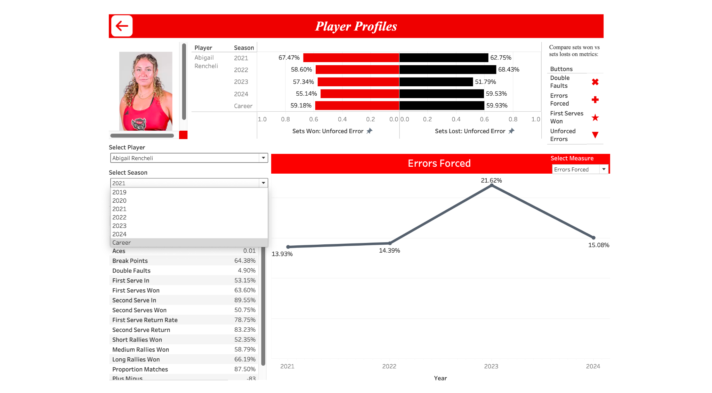

Slide 9
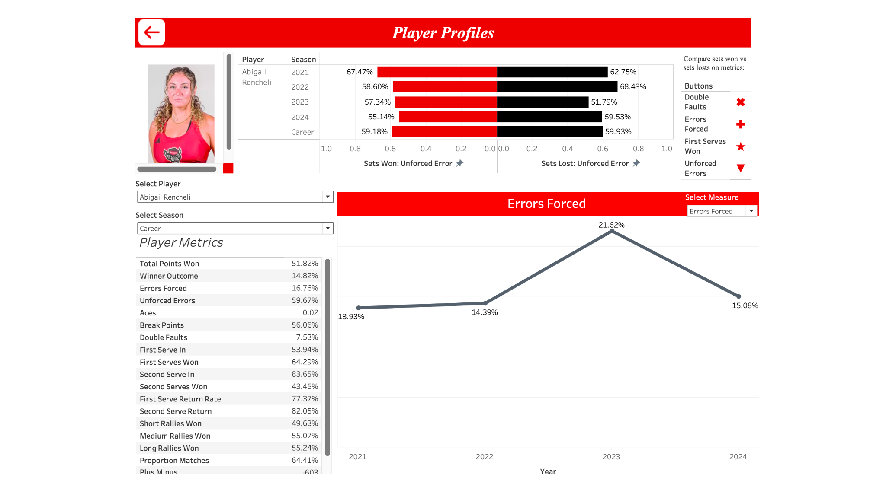

Slide 11
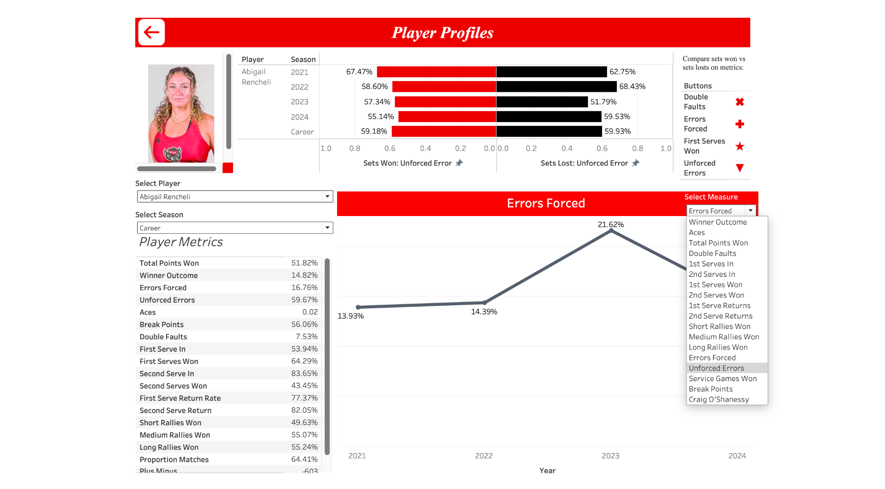

Slide 12
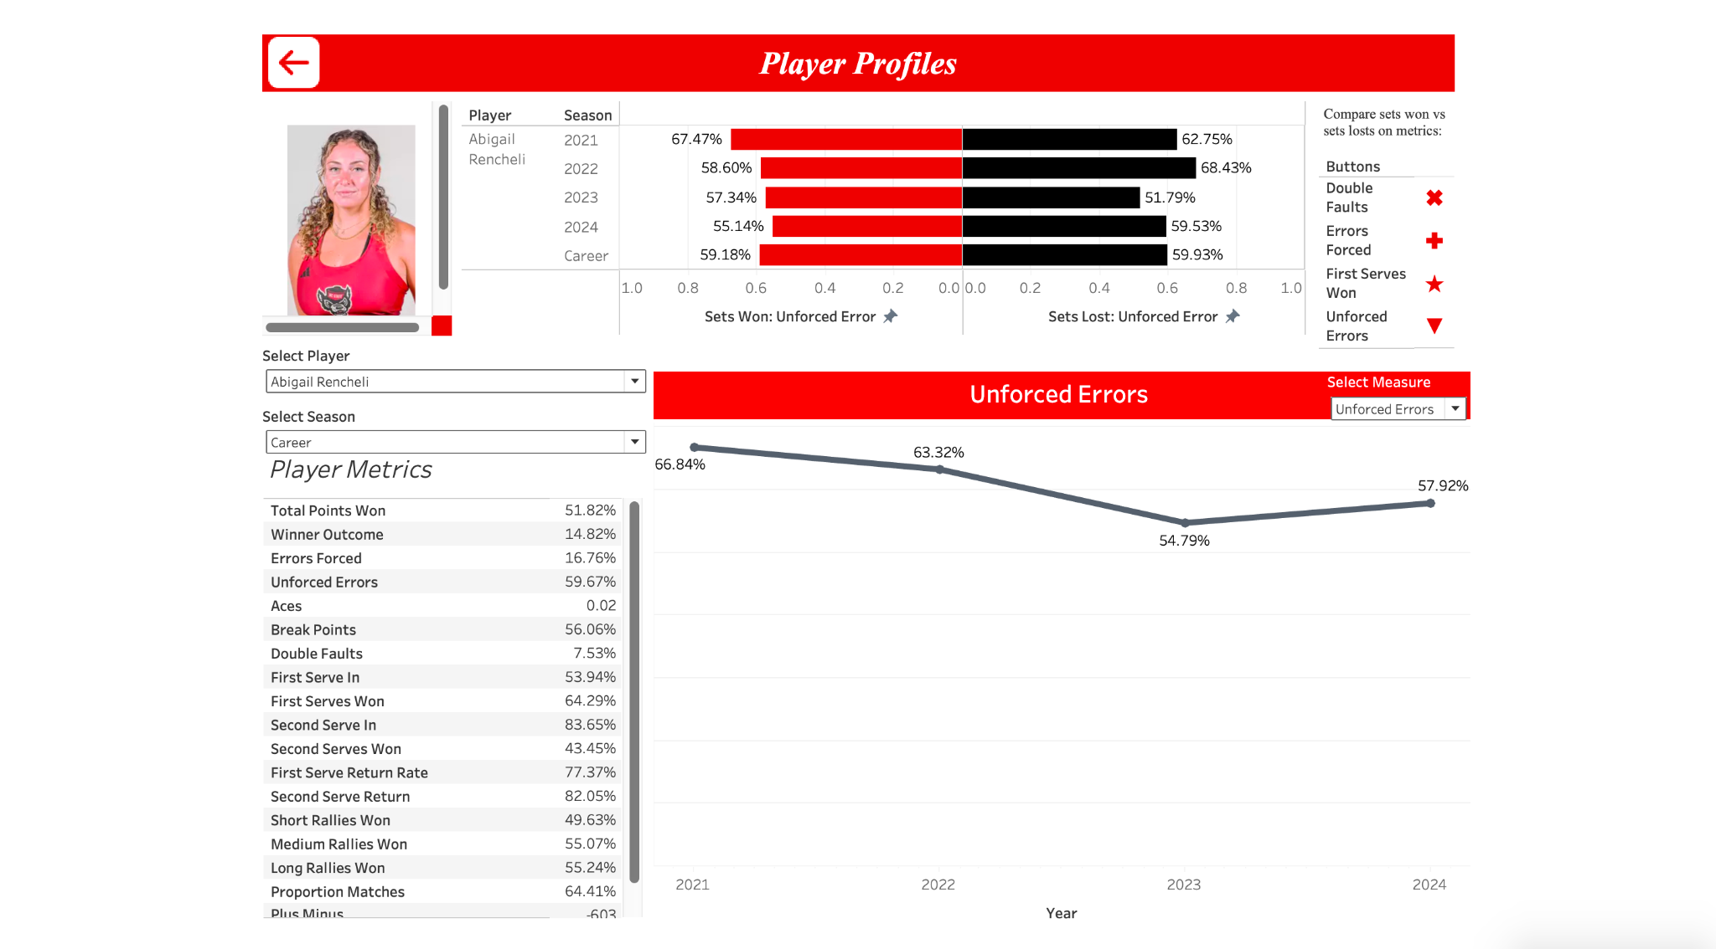

Slide 16
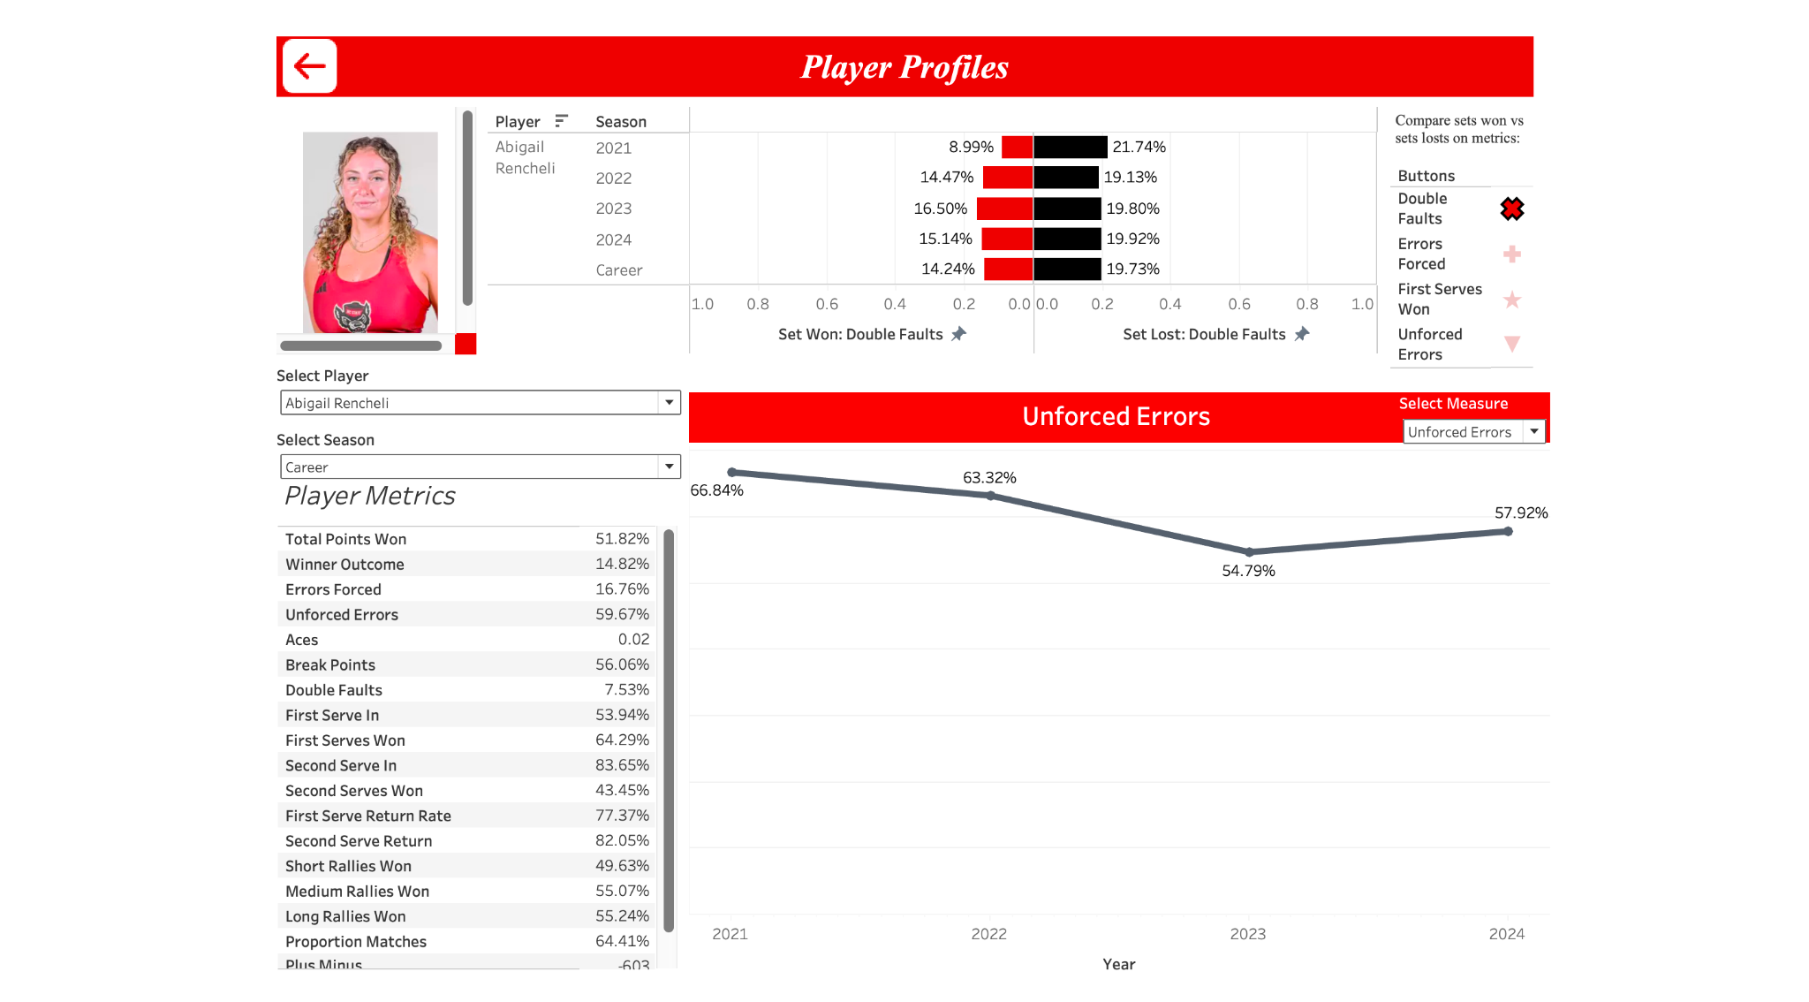

Slide 18
Notes:
Now we’re back to the home screen.

Slide 19
Notes:
Below individual stats, lets take a look at the team leaderboard

Slide 20
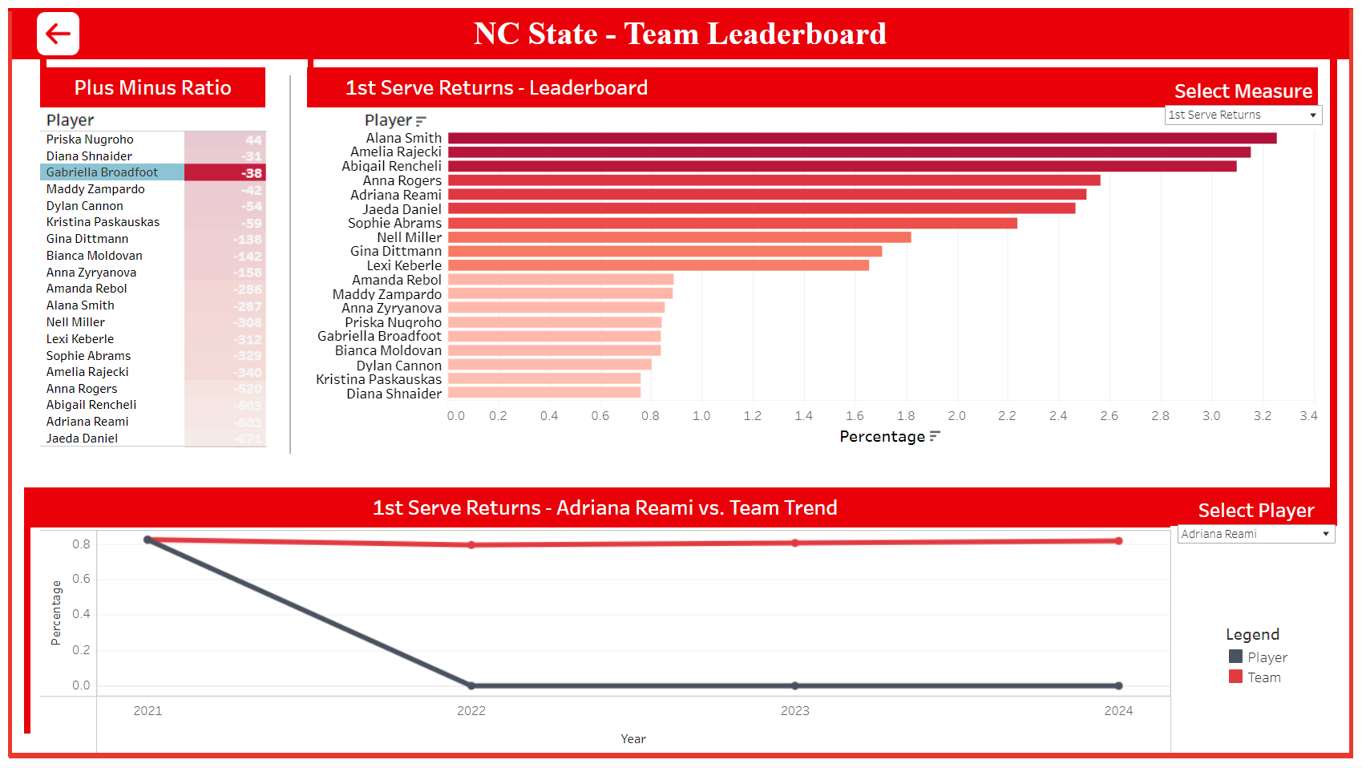

Slide 21


Slide 22
Notes:
On the next pane we have a leaderboard for a specific metric.

Slide 23
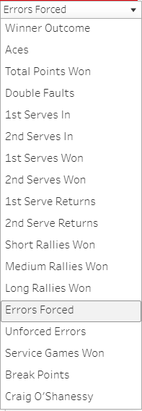
Notes:
These metrics can be toggled to show what we want to see a leaderboard for…. Lets say I want to look at errors forced today.

Slide 24
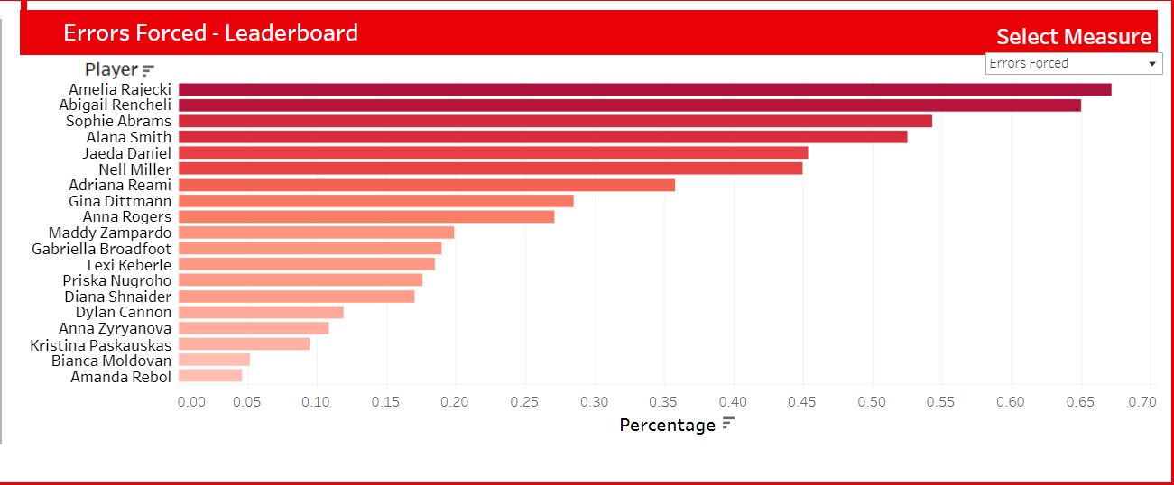
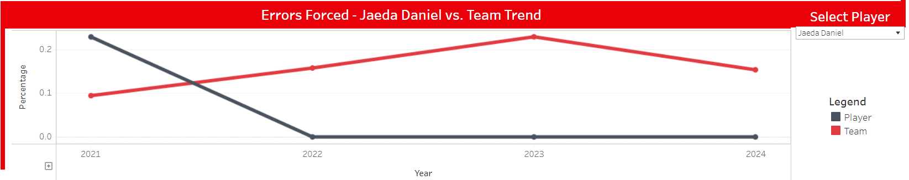
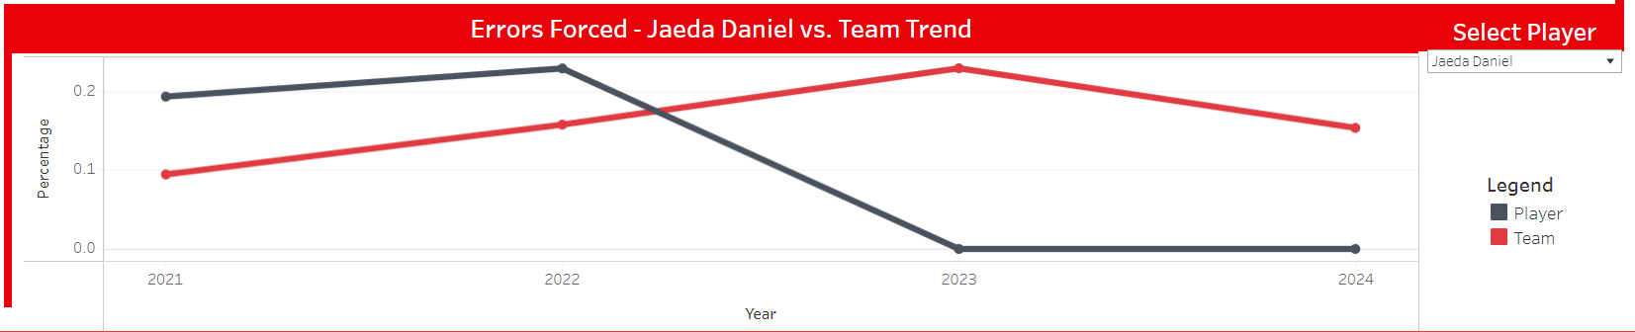
Notes:
Now i can quickly compare the percentages of errors forced, sorted from the greatest to least, shaded using the same criteria. Amelia Rajecki has the most errors forced and I can quickly see how any other player compares to her.

Slide 25
Notes:
On the bottom pane we have a ongoing comparison between a players performance as well as the teams performance overall. The grey line is the player and the red line represents the teams performance.

Slide 26
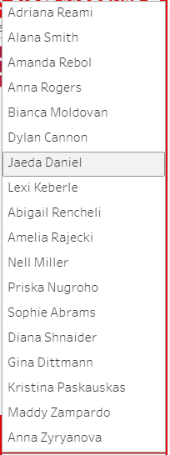
Notes:
From here I can also quickly choose a player to measure how well they are doing as compared to the team average.

Slide 27
Notes:
Im interested in seeing how Jaeda Daniels performed compared to the team relatively.

Slide 29
Notes:
Using both of these charts, we can quickly understand how players are doing against each other on each of the metrics as well as understand how each player is doing against the team as a whole relatively.

Slide 30
Notes:
Back to the main page

Slide 32
Notes:
And into WTA players

Slide 33
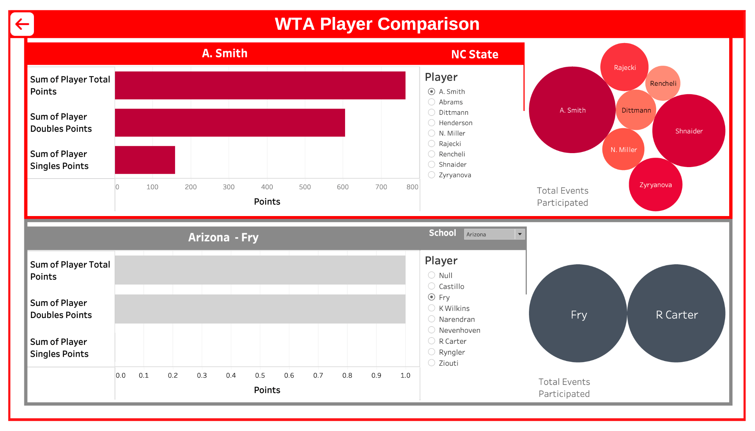

Slide 34
Notes:
At the top half of the screen we represent NC state

Slide 35
Notes:
The bottom half of the screen will be for various other schools

Slide 36
Notes:
The first section compares two players with the sum of their total points

Slide 37
Notes:
The middle section allows for a toggle between players up top and then for school and players below.

Slide 38
Notes:
Finally the last section show show many events were played relatively to other players on their respective school team.

Slide 40
Notes:
Today We want to see how many points rencheli has scored

Slide 41
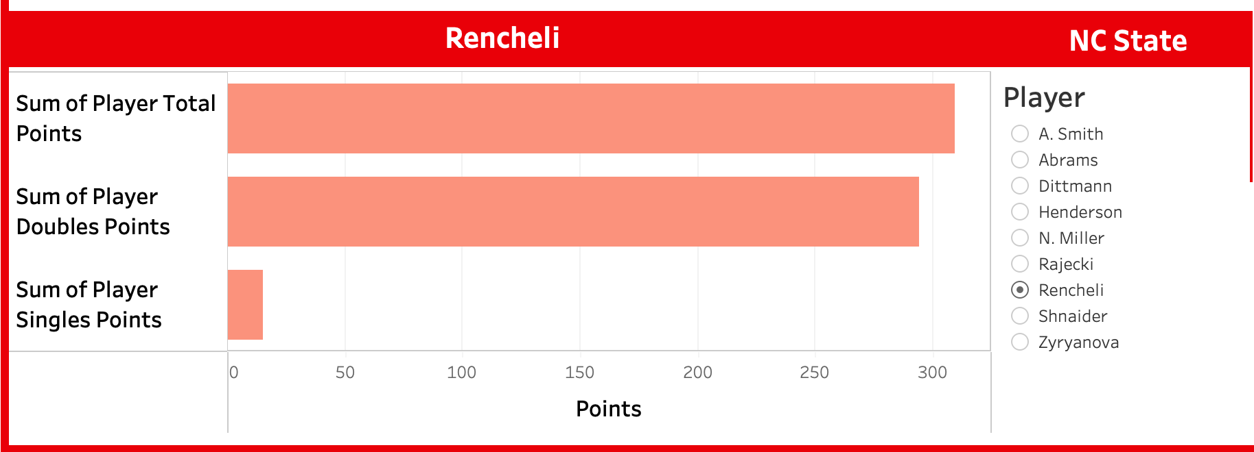
Notes:
A little over 300 and most of them are double points, maybe she can play in more singles? But im curious how rencheli compares against beck from duke.

Slide 42
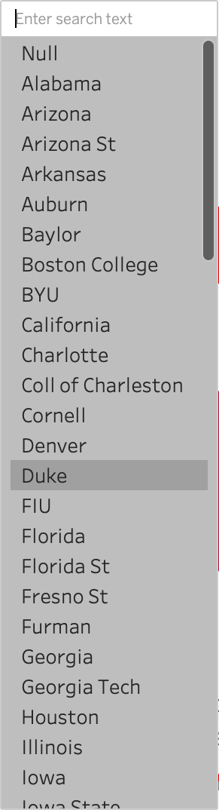
Notes:
So lets select duke from the dropdown.

Slide 43
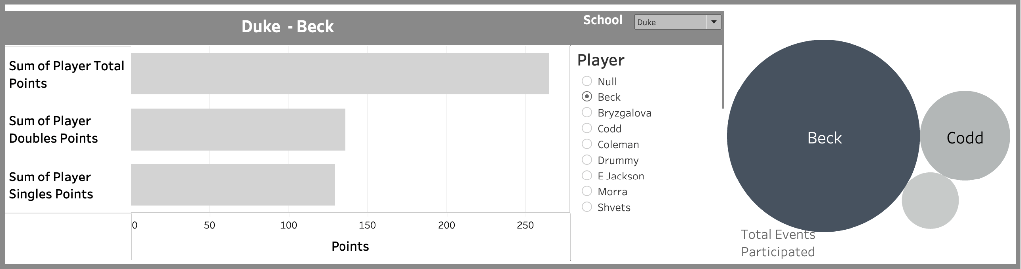
Notes:
And select beck from the players

Slide 44
Notes:
Interestingly enough some of their players have zero presence in events.

Slide 48
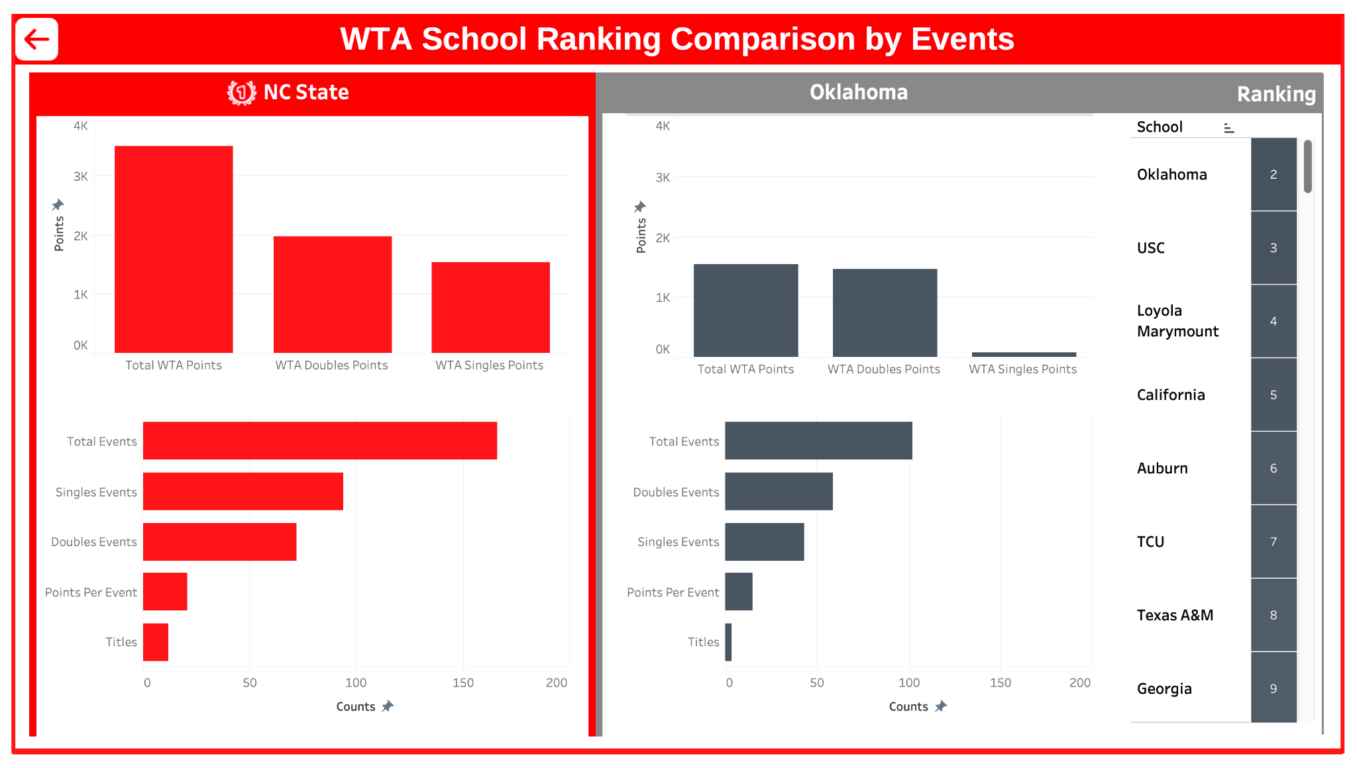
Notes:
Lastly lets look at WTA teams.

Slide 49
Notes:
On the left hand side we see NC states perfomance

Slide 50
Notes:
The right hand side shows opposing schools

Slide 51
Notes:
And to the right of that shows rankings as well as allowing us to select another school for comparison

Slide 52
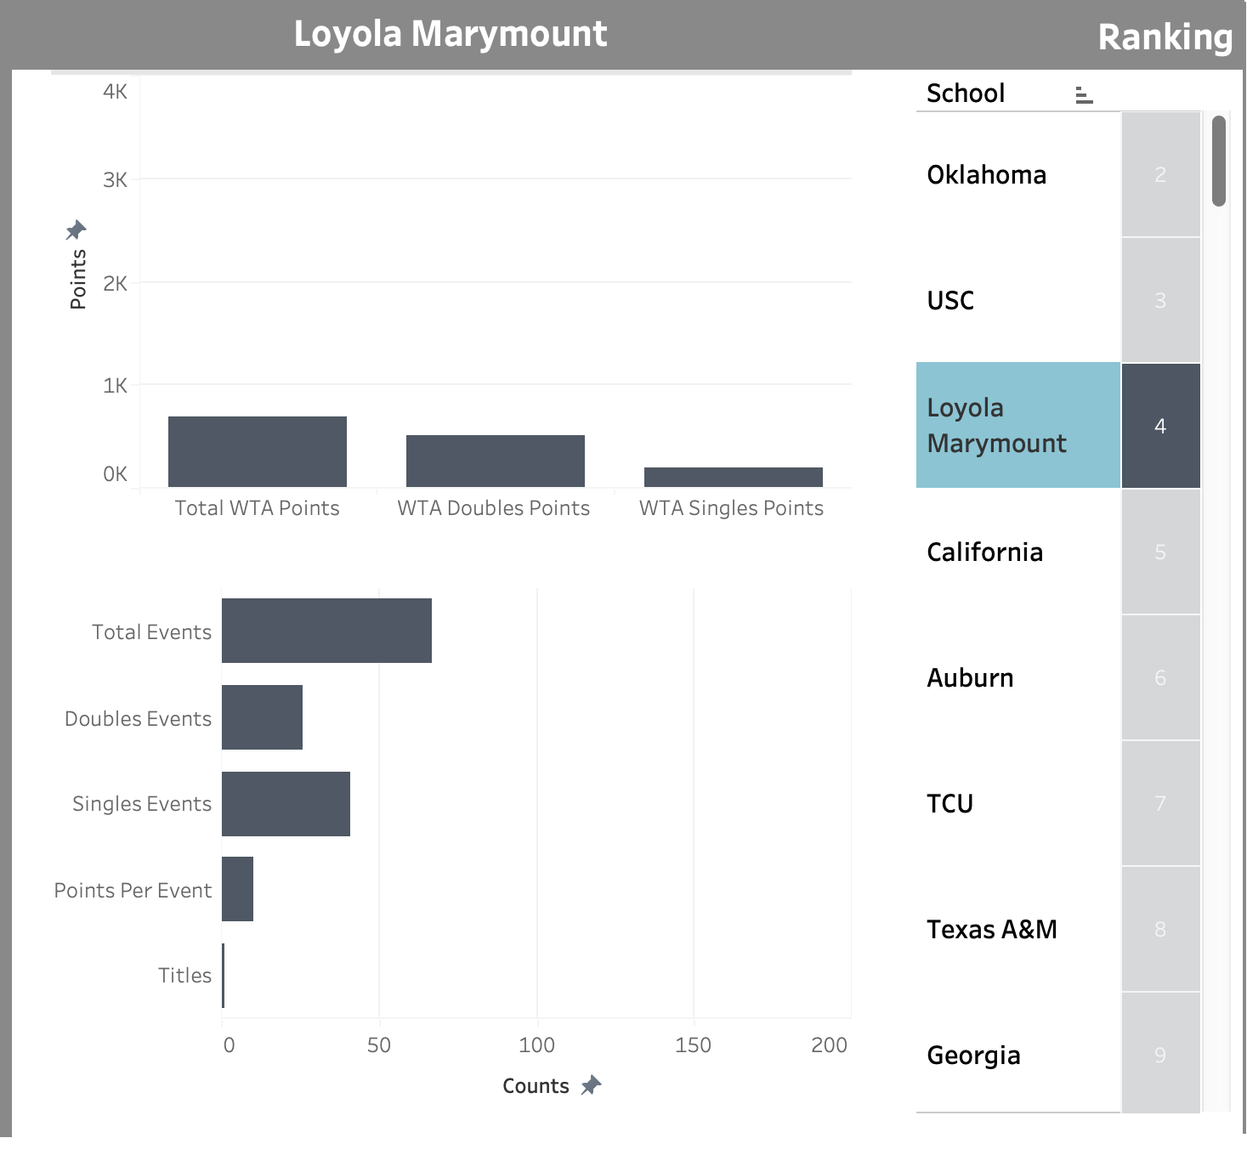
Notes:
Lets look at two of them, here is loyola marymount with about 0 titles

Slide 53
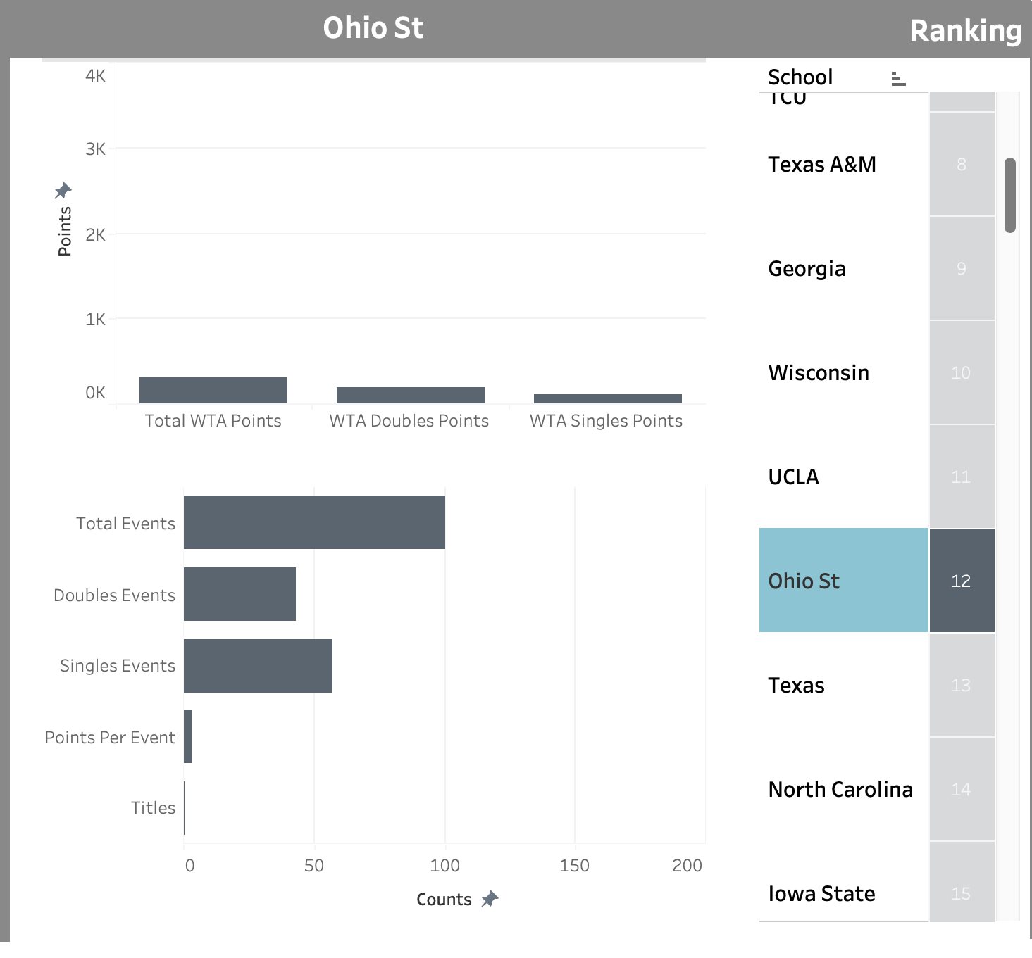
Notes:
And Ohio State with about the same amount of titles and very few points.

Slide 54
Notes:
We can quickly compare two schools based on the total amount of points

Slide 55
Notes:
Or the total amount of events.

Slide 56

Notes:
And its hard to say which school is better but when you compare them it should be pretty obvious.

Slide 57
Questions?
Check Out Our Live Dashboard Now!

